Slide 1
Updates
5/5/21

Slide 2
Poster
https://docs.google.com/presentation/d/1j9tiB8pkxBHM8gazKxWD05_6DJAI6SFQaRuIMh5oYJ4/edit

Slide 3
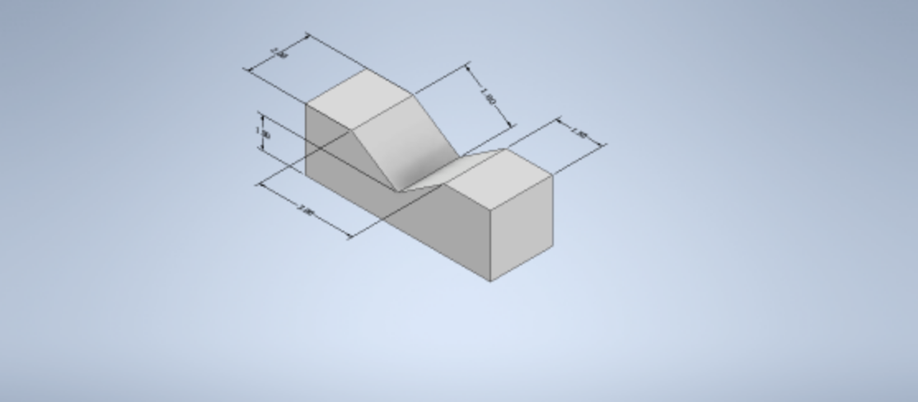
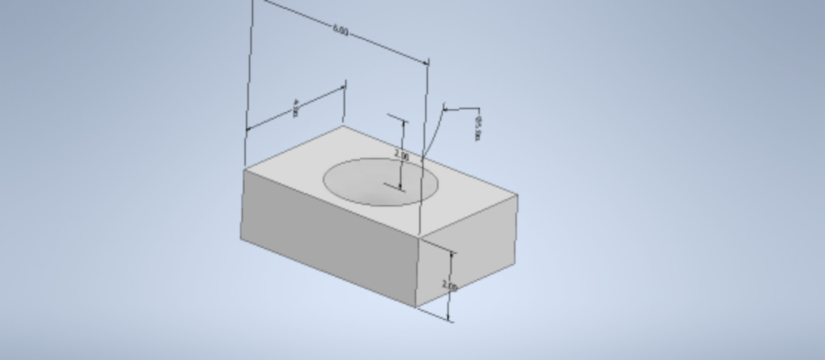
Samples
Finishing up missing samples
Missed T1 samples at 40, 60 and 80% infill for compression
T4 samples for compression
Continued printing
Finished up aligned (concentric) prints for 40, 60 and 80% infill for compression and tension
T1
T4

Slide 4
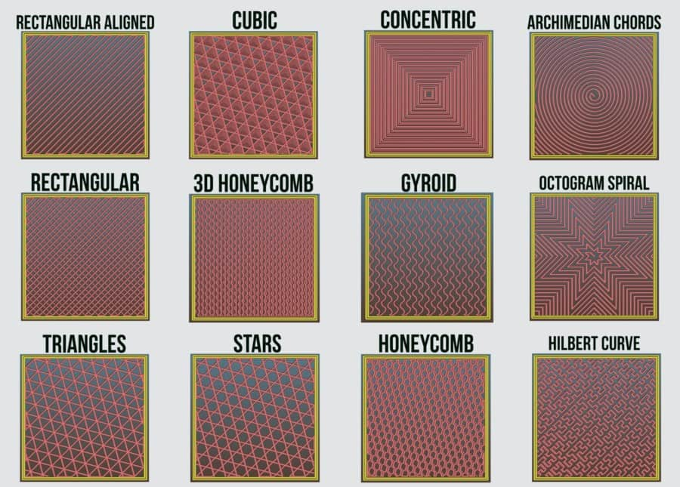
Different infill patterns
Notes:
Sample: T1
Infill percentages: 40,60,80
Total # of samples: 36 (tension and compression)

Slide 5
Printing
6 samples each of T1 40,60,80 % rectilinear for compression
All T1 aligned finished
40,60,80% for tension and compression
Summer Work: ABS and Carbon Fiber printing

Slide 6
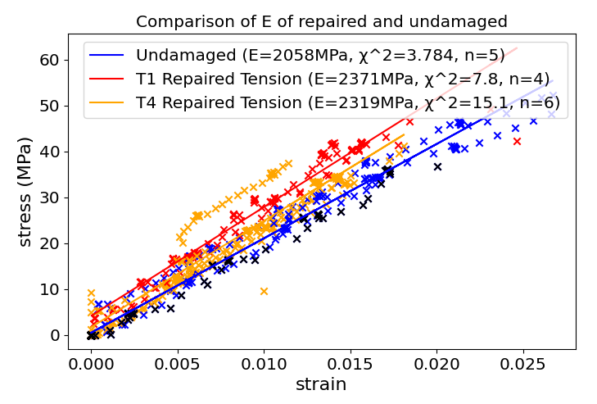
Testing
Aidan
Initial data of undamaged samples matches Eric’s data closely
Aidan’s data shown in black on chart to the right
Just received aluminum bars so we can compare aiden with eric against known
Eric
Tested 40% hex infill under compression
Tested 80% aligned infill under tension

Slide 7
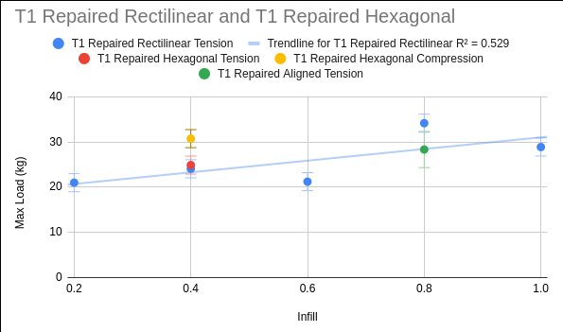
Data
T1 Hexagonal 40% Compression Testing done
The trend continues that repairs are significantly stronger under compression.
Not stronger than the undamaged parts like the 100% infill repairs in compression, but still significantly stronger

Slide 8
Timeline
https://docs.google.com/spreadsheets/d/1oa-Z-vQIIZ6xVn4PNoHb93SB0EdPG6uHLpalY9HMLck/edit#gid=0

